Slide 1
Data Analysis on Depression
Aug 2019
Siyu Zhang

Slide 2
Motivation – Depression Prediction
The project is designed for a health management tool to help clients to prevent depression
Potential Variables:
Age, gender, education, veteran, income, marital status
Diet, exercise, body build(BMI), smoking, drinking alcohol
Cholesterol level, blood pressure
Target:
Diagnosed depression
Fun Result:
A married female with an unhealthy diet, smoking, drinking with high cholesterol is more likely to have depression
Higher income with no smoking or alcohol would less likely to have depression

Slide 3
Data Collection - BRFSS
Data Source: The Behavioral Risk Factor Surveillance System(BRFSS)
Ongoing health-related telephone surveys
Collect data on health-related risk behaviors, chronic health conditions, and use of preventive services from the noninstitutionalized adult population
Contains 358 variables for a total of 450,016 observations in 2017
It’s based on a large stratified random sample

Slide 4
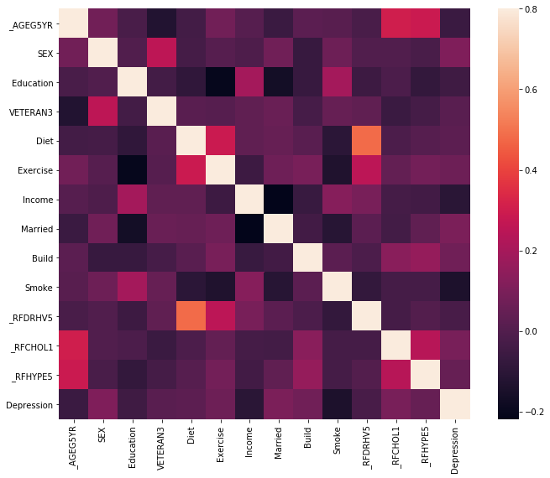
Dataset Analysis
Data Processing:
Fill NA
Data binning
Check correlations
Symbol | Description | Data Binning
_AGEG5YR | Reported age in five-year age categories calculated variable | NA
SEX | Respondents sex | nA
EDUCA | Education level | Narrow to 4 categories, value 1 for not graduate High School or Unknown, value 2 for graduated High School, value 3 for attended college or technical school, value 4 for graduated from college or technical school.
VETERAN3 | Are you a veteran | NA
FRUIT2 | How many times did you eat fruit | Narrow to 2 categories, value 1 for having fruit or vegetables every week, value 2 for once more than a week or never or unknown
FRUITJU2 | How many times did you drink 100 percent pure fruit juices
FVGREEN1 | How many times did you eat dark green vegetables
VEGETAB2 | How many times did you eat other vegetables
EXEROFT1 | How many times walking, running, jogging, or swimming | Narrow to 3 categories, value 1 for exercise every week, 2 for exercise every month, 3 for never or unknown
INCOME2 | Income level | Narrow to 4 categories, value 1 for less than $50,000, value 2 for $50,000 - $75,000, value 3 for greater than $75,000, value 4 for unknown
MARITAL | Marital status | Narrow to 2 categories, value 1 for married, value 2 for all other situations
_BMI5 | Body Mass Index | Narrow to 4 categories, value 1 for underweight, value 2 for normal weight, value 3 for overweight, value 4 for obese
SMOKE100 | Smoked at least 100 cigarettes | Narrow to 4 categories, value 1 for Every day smoker, value 2 for Someday smoker, value 3 for Former smoker or unknown, value 4 for Non-smoker
SMOKDAY2 | Frequency of days now smoking
_RFDRHV5 | Heavy alcohol consumption | NA
_RFCHOL1 | High blood cholesterol | NA
_RFHYPE5 | High blood pressure | NA
ADDEPEV2 | Ever told you had a depressive disorder | Narrow to 2 categories, value 1 for yes, value 2 for all other situation

Slide 5
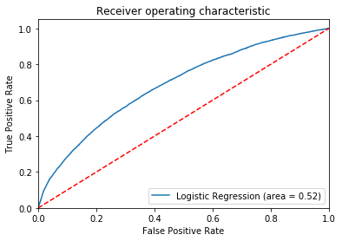
Result Interpreting
The confusion matrix
Overall accuracy: 0.80
The model has better result predict non-depression samples, the precision is 0.81 and the recall is 0.99
As for the depression samples, the precision is 0.56, but the recall is only 0.05.
Interpreting
The cause of depression could be very complicated and not easy to define.
The data analyzed is self-reported health survey data, which might be biased due to the respondents’ lack of awareness of their risk status.

